Slide 1

Tokenisation for the Taiwan Mandarin Corpus

Slide 2
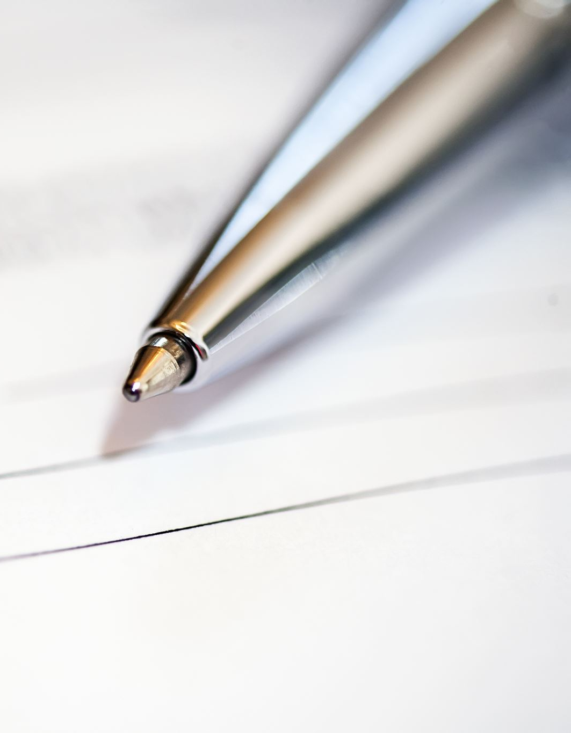
Introduction to tokenisation and tokenisation standards

Slide 3
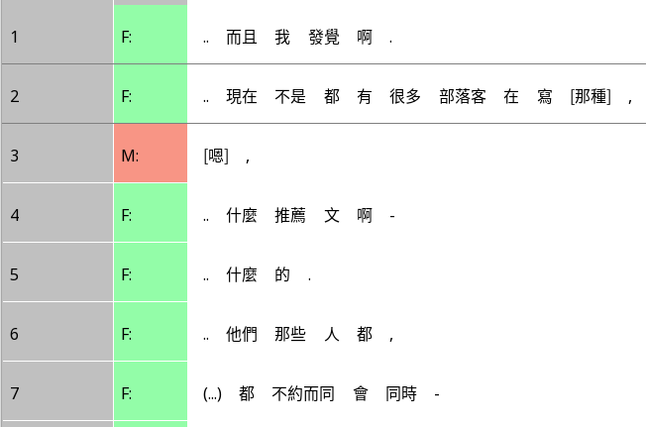
What is tokenisation?
When dealing with texts, we often need to segment it into individual parts
A token is a small and useful unit
In Chinese, a token roughly corresponds to a 詞語 or 標點符號
Rezonator only accepts tokenised text as input

Slide 4
Standards of tokenisation
Mainland Chinese standard
American standard (University of Washington)
Taiwanese standard

Slide 5
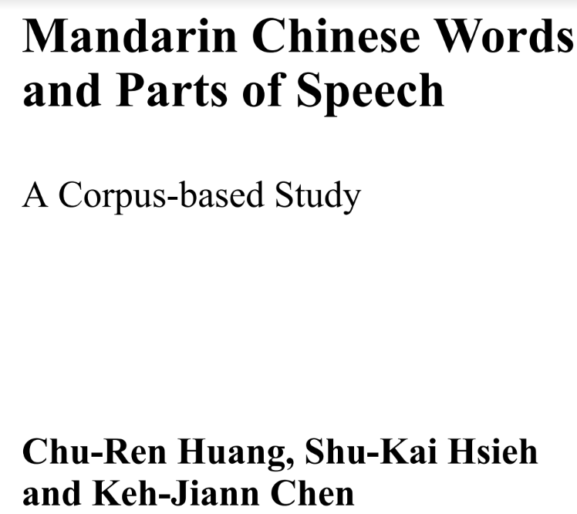
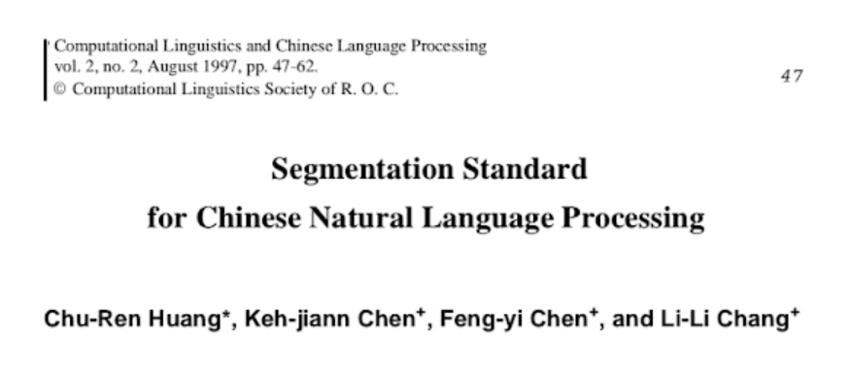
What we’re using
The paper: General principles
The book: Specific examples
Both on the Google Drive

Slide 6
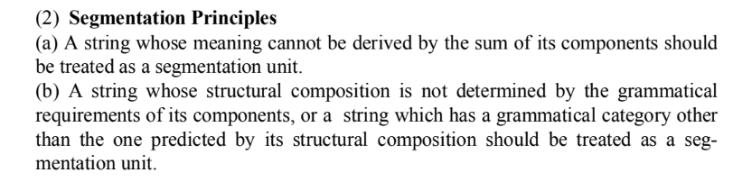
Segmentation principles
Therefore, 明天 should be one token – it doesn’t mean bright + day
Therefore, 出入 should be one token – it is made of two verbs, but becomes a noun ‘discrepancy’

Slide 7
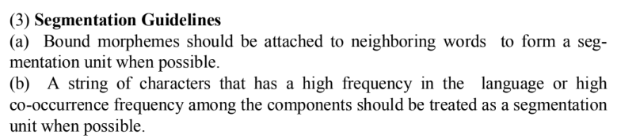
Segmentation guidelines (I)
學校 should be one token – 校 is something we never say by itself
水瓶 should be one token – very frequent

Slide 8
Segmentation guidelines (II)
阿爾伯特·愛因斯坦 is two tokens
[中華[人民[共和國]]] should be segmented: 中華 人民 共和國

Slide 9

Transcription convention and tokenisation

Slide 10
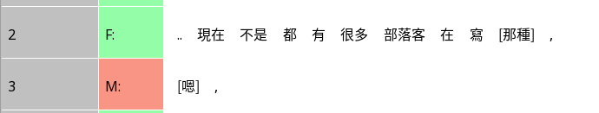

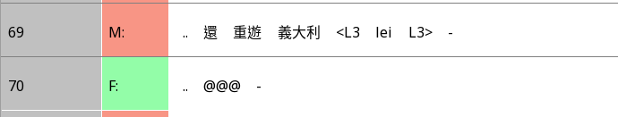
Some transcription symbols
Overlap brackets [] [[]] [22]
Endnote , . -- ?
Pause .. (…) (.)
Endnote
Non-Mandarin <L2 L2>
Lengthening: =
Laughter: @

Slide 11
Rules regarding transcription conventions
Overlap brackets should be stuck to the characters they enclose
Overlap brackets may also be stuck to a character outside if it’s in the same token as the first character inside. E.g. 七[手八腳 的 同]學
Consecutive pulses of laughter should be one token e.g. @@@
Lengthening belong to the previous token: @@=
Everything else (e.g. endnote, pause) should be separate tokens

Slide 12
Practical steps
First use 1_auto_split.R to automatically split the text into intonation units; result should be stored in 1_auto_split
Then use 2_auto_tokenise.R to automatically tokenise the text; result should be stored in 2_auto_tokenized
Use a program like Atom to open the CSV, then listen to the recording and tokenise
At the same time that you tokenise, listen for errors in the transcription and correct them
Check with your partner and agree on a final tokenization + transcription

